Slide 1
Vacation Rental Dwelling Ordinance Update
City of Bandon City Council
March 6th, 2023

Slide 2
Last Ordinance Update
Defined “existing single-family detached dwelling” as being at least three years old.
Confirmed “single-family detached dwellings” as the only dwellings eligible for VRD status. Excludes duplexes and attached condos/townhomes.
Restrict VRD’s in the CD-1 zone to the area generally along and accessed by Beach Loop Drive. Excludes CD-1 areas approximately 400’ east of Beach Loop Drive.
VRD’s limited to specific applicant/owner, and do not transfer upon sale. Lose VRD status upon change of applicant/owner.
Maximum occupancy ultimately determined by PC based upon specific site and neighborhood characteristics.

Slide 3
This Ordinance Update
Clarify the saturation rate calculation, including that the subject property and all permitted VRD units are included in the calculation.
The Planning Commission may now limit the allowable parking area and the number of parked cars allowed on-site.
Require a 96-gallon trash service; trash cans must be removed from City right-of-way within 24-hours of pick up.
Requires all other permitting agency approval before operation.
Rental permit information must be posted inside.
Life/safety regulations applies to all vacation rentals, not just new ones.
New definition of “owner.” Only one VRD per owner.

Slide 4
This Ordinance Update
City Manager can require new information/pamphlets be posted in a VRD.
General regulations apply to all Vacation Rental Dwellings (not just new).
Coos County Building Department now requires a building permit to operate a short-term rental. May require sprinkler system if deemed commercial.

Slide 5
Saturation Rate
Existing Language:
Less than 30% of the single-family detached dwellings within 250 feet of the subject property, and located in a zone where VRD’s are allowed, are VRD’s
Proposed Language:
Including the subject property, the saturation rate within a 250-foot radius of the subject property must be less than 30%. The saturation rate is calculated using the following ratio:
Numerator: Subject property + permitted VRD units (each unit within a multi-family VRD is counted individually)
Denominator: Subject property + eligible properties (single-family detached dwellings)

Slide 6
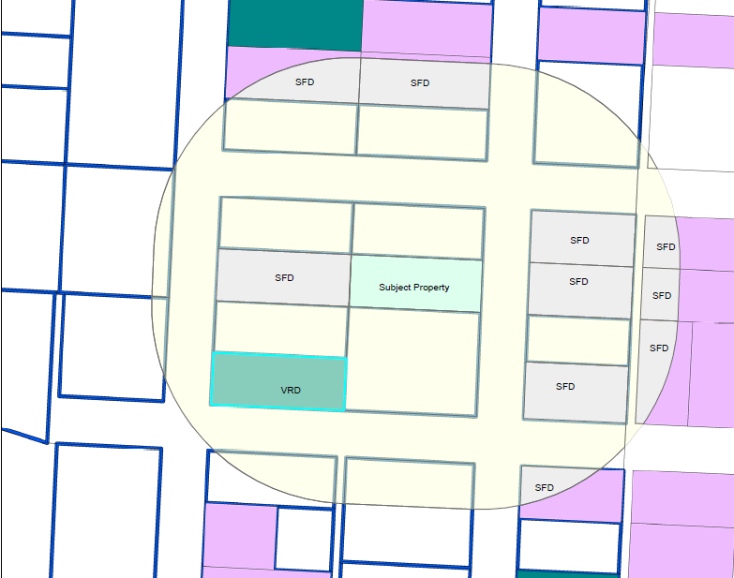
Examples
VRD Rate Existing
0 VRDs / 10 SFDs = 0%
VRD Rate Proposed
3 VRD Units / 11 SFDs = 27%
Multi

Slide 7
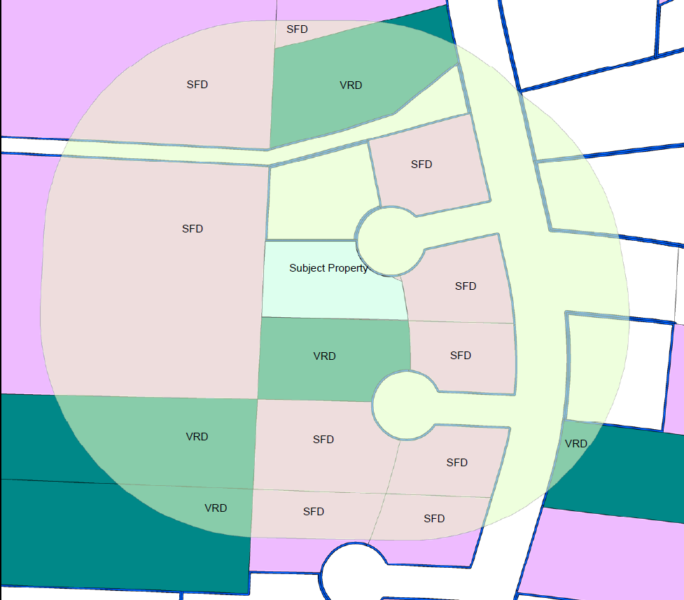
Examples
Multi
VRD Rate Existing
3 VRDs / 13 SFDs = 23%
VRD Rate Proposed
8 VRD Units / 14 SFDs = 57%
Multi

Slide 8
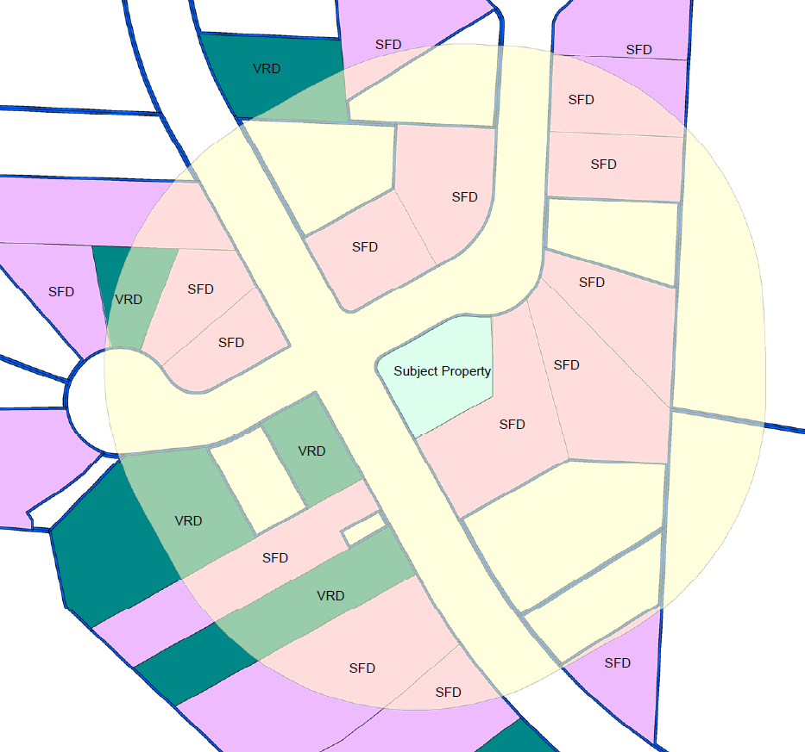
Examples
VRD Rate Existing
4 VRDs / 20 SFDs = 19%
VRD Rate Proposed
7 VRD Units / 21 SFDs = 33%
Multi

Slide 9
Planning Commission Recommendation
Approve changes as recommended
Could not come to consensus about whether or not to lower saturation rate to 20%. Recommended somewhere between 20% – 30%.
More work may be needed at a later date to further discuss signage, allowance of room rental, and a balance of commercial and residential uses.

