Slide 1
MOBILE FOOD UNITS CITY COUNCIL PUBLIC HEARING 9.12.22

Slide 2
PROCESS FOR ADOPTION
PAPA Notice submitted to DLCD on Feb. 17th
Notice of Public Hearing mailed on March 2nd
Notice public in The World on March 4th
First evidentiary hearing March 24th
Additional Public Hearing April 28th for deliberation only
City Council Work Session August 15th
Notice published in The World on August 26th, 2022

Slide 3
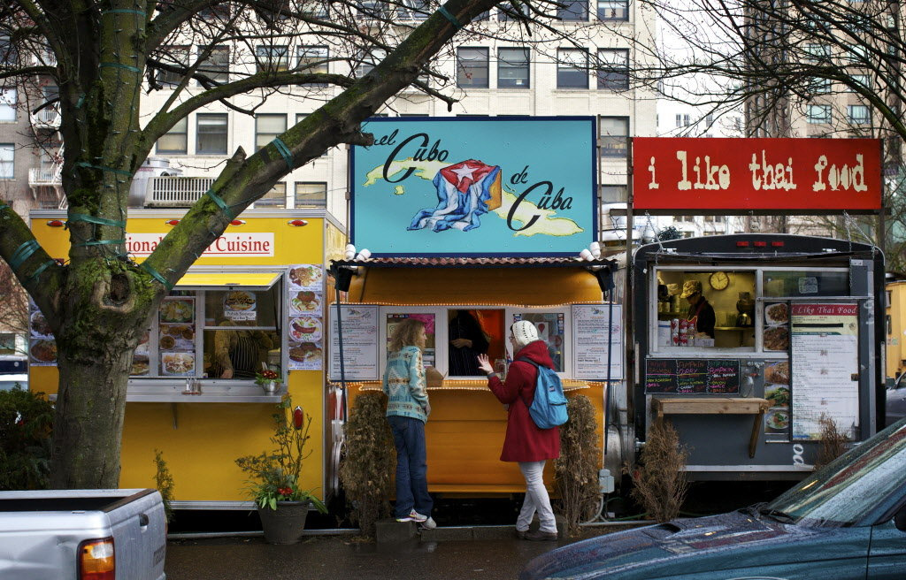
What are Mobile Food Units?
A vehicle that is self-propelled or that can be pushed down a sidewalk, street, or highway, on which food is prepared or processed and is used in selling and dispensing food to the consumer.
There are also Mobile Food Pods:
A designated site on which more than one Mobile Food Cart is located, with shared facilities for restrooms, seating, trash, and other accessory features.

Slide 4
Code Provisions
Trash
Parking
Signage
Commercial Design Standards
Annual Operating Permit

Slide 5
Procedural
Is the text consistent with the City’s Comprehensive Plan? Will the proposal adversely affect land use, transportation, or utility service needs and capacities?
Policies:
Tourism, diverse economy, attract youth.

Slide 6
Survey Results
“It’s a great idea all the way around for locals and tourists to bring a variety of foods quickly available. Especially during the Summer months when restaurants can get overwhelmed. Food trucks bring a vibrancy to areas if set up correctly. They also give small business a way to get started. They can be a revenue source for the city. Definitely all in for mobile food vending in Bandon.
“Food trucks are an awesome way for people to begin their journey in ultimately owning a restaurant. I think we should support that and potentially other types of mobile/public vending.”
“I love the idea, for residents, visitors and vendors. My only concern is to make sure they have plenty of trash cans.”

Slide 7
RECAP OF PUBLIC COMMENT
Concern about location in Old Town
Cover “fair share” (taxes, rents, fees, etc. that brick & mortars pay)
Concern about needed parking
Like food carts, but wants to see reasonable regulations

Slide 8
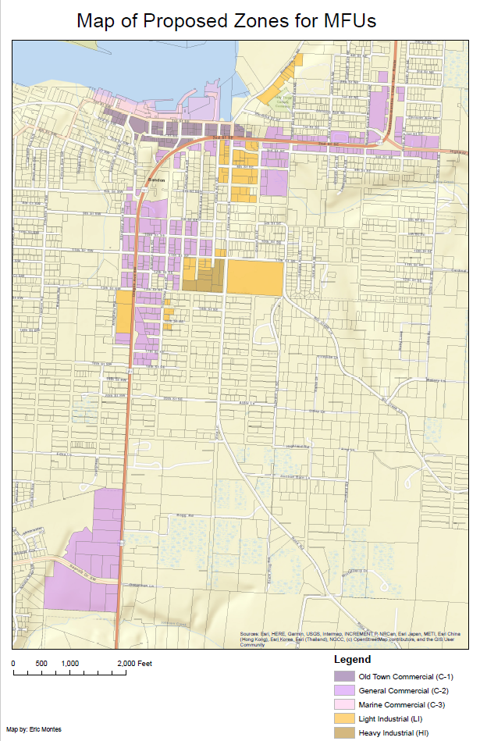
CHANGES TO DRAFT
MFUs shall only be permitted on private property in the C-2 and LI zones, subject to property owner approval.

Slide 9
RECOMMENDATION
Planning Commission passed to Council as recommended without comment on location. Staff recommends approval of Ordinance with allowance only in C-2 & LI zones.
Potential Motion: “I move to approve the land use ordinance as proposed (and/or as amended here) for the zone text amendment to chapter 17.104, Supplementary Provisions of the Bandon Municipal Code and direct Staff to prepare an Ordinance and Findings for adoption at the next meeting.”

Slide 10
Questions?

